Slide 1
Manipulating CSS Class Properties Using JavaScript

Slide 2
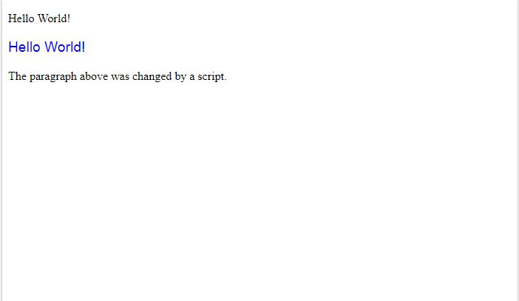
getElementById
<html>
<body>
<p id="p2">Hello World!</p>
<script>
document.getElementById("p2").style.color = "blue";
</script>
<p>The paragraph above was changed by a script.</p>
</body>
</html>

Slide 3


Event Listening
<!DOCTYPE html>
<html>
<body>
<h1 id="id1">My Heading 1</h1>
<button type="button"
onclick="document.getElementById('id1').style.color = 'red'">
Click Me!</button>
</body>
</html>

Slide 4
New Kids on the Block
querySelector:
var element = document.querySelector("< CSS selector >");
Example
var element = document.querySelector("#main");
selects the element with the Id of main
var element = document.querySelector(".pictureContainer");
selects the element with the Class of pictureContainer
querySelectorALL:
var element = document.querySelectorAll("< CSS selector >");
Example
var images = document.querySelectorAll("img");
selects ALL the element with an img tag

Slide 5
Two Ways to set CSS
Style Directly:
var myElement = document.querySelector("#superman");
myElement.style.backgroundColor = "#D93600";
Adding/Removing Classes:
var theDropDown = document.querySelector("#dropDown");
theDropDown.classList.add("disableMenu");
var theDropDown = document.querySelector("#dropDown");
theDropDown.classList.remove("disableMenu");

Slide 6
Live Example – Slide Menu

